Slide 1
Prospects of Employment Opportunities in the Arabian Gulf
SELF EMPLOYMENT
March 16,2017
Presented By:
Sabah Almoayyed

Slide 2

Self Employment
What is Self Employment ?
              Self-employed is a situation in which an individual works for himself instead of working for an employer that pays a salary or a wage
              The importance of small business in our economy even the business is small, they provide both jobs and innovation.
              Its a totally different lifestyle. The success or the failure of the business rests on person shoulders.
              Being self-employed requires a personal commitment that is greater than what most jobs will generate. This can mean very long hours, many days of each week, and be an enormous source of pride.

Slide 3

Advantages & Disadvantages of Self Employment
Advantages of being self-employed
You are your own boss and have the chance to put your ideas into the business
You work hard and enjoy the rewards of your hard work
You get to feel the enormous sense of pride and personal satisfaction when your business is successful
You will have the opportunity to lead others and work closely with your customers
Disadvantages of being self-employed
Risk of failure and your decisions can be wrong (two-thirds of small
businesses make it past the two-year anniversary and 44% reach their four-year anniversary.
Owning your own business can require a sacrifice of your personal life
Your income stream may fluctuate throughout the year
Your health insurance and pension costs are not included automatically
Strict record keeping and attention to detail are very important

Slide 4
How to Manage Self Employment
Ways to make your job secure (tips to make your income more regular and reliable)
Diversify
Be financially savvy
Make sure your services are in demand
Cultivate a mix of long and short-term clients
Join freelancer networks and platforms
Be very clear about payments due
Get it in writing

Slide 5
What do you need for starting your Business
Business Plan - This not only helps you determine what you’ll need to launch the business, but also will help you secure a loan or investment capital and operate the business after you open.
Funding - It’s simply a fact that your business will need capital, assess how much you need to start your business and maintain operations
Management - Strong team members can be recruited using a variety of methods, Staffing agencies and executive search firms specialize in placing talent of all levels within every industry.
Monitor - Benchmarking, Variance Analysis, Trend Analysis are the methods of monitoring your business’s performance. Monitoring your business is a great way to ensure maximum productivity and profit.

Slide 6
How to Scale / Grow
Who really benefits from the growth of self-employment?
Creative and qualified self-employed individuals contribute in economic growth by inventing new products, production processes, distribution methods, and employing other people.
Self employment can affect both intragenerational and intergenerational economic mobility through its direct effects on income and wealth.
Self-employment leads to an increase in the earnings distribution for low-income individuals but a decrease for high-income individuals

Slide 7
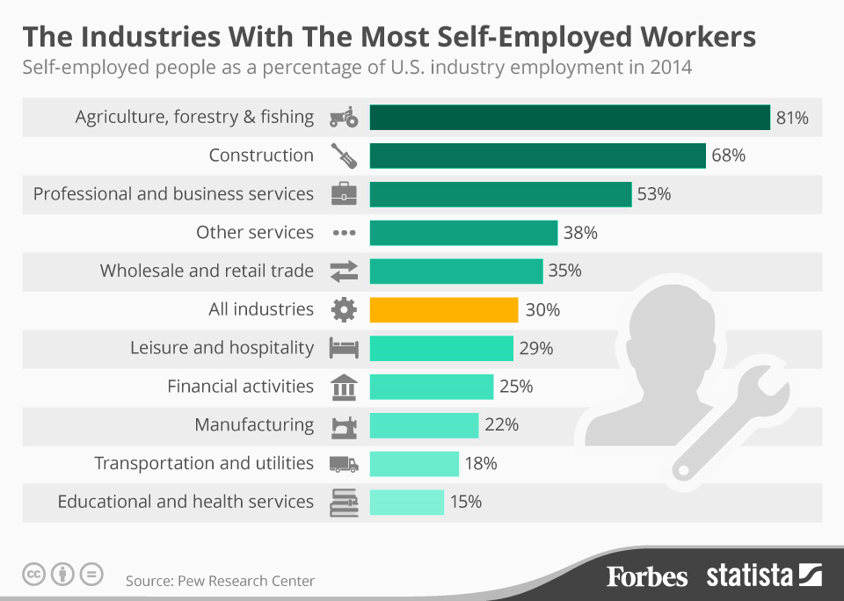
Industry Understanding
Which Industries Have The Most Self-Employed Workers?
When it comes to the industries with the most self-employed workers, agriculture, forestry and fishing comes first. 81 percent of those working in this sector are self-employed.
Resources: http://www.forbes.com/sites/niallmccarthy/2015/10/26/which-industries-have-the-most-self-employed-workers-infographic/#cce06c56d829

Slide 8

Continuous Learning
Learning How to Collaborate When You’re Self-Employed
Here are five questions to ask yourself in order to determine when collaboration is worthwhile.
Is there demand?
Does your collaborator add unique skills
Does it help you cement a relationship
Does it provide a chance to spend time with friends
Do you trust your collaborator implicitly

Slide 9
Self Employment in GCC
Levels of Self Employment in GCC
Rate of entrepreneurship ranging between 3 percent and 4 percent of the working population in Kuwait, Oman, Bahrain and the UAE.
Qatar, where only 0.5 percent of the workers have set up their own business, and, on the other hand, Saudi Arabia, where the number goes up to 8 percent, with the caveat that the number was estimated, for the last time, 23 years ago.

Slide 10
Self Employment in Middle East
Reasons' for preferring to be ‘self employed ‘ by country
64 % aged 18 and above would rather have their own business than be employed in MENA Region.
8 out of 10 fresh graduates in the MENA turning their backs on traditional career path and instead become owners and runners of their own business.

Slide 11
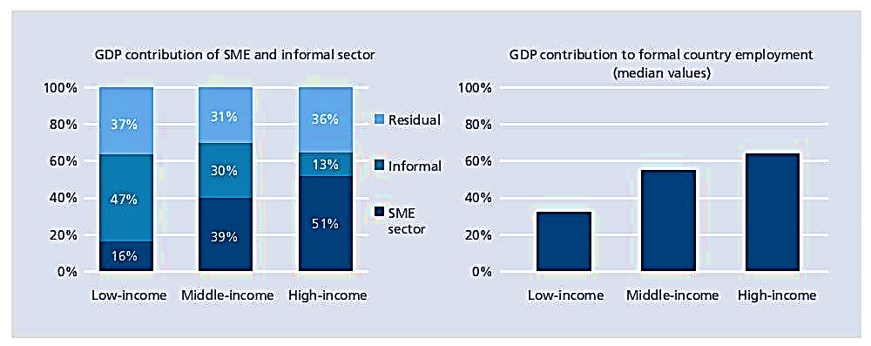
Self Employment in Middle East
Self Employment Contribution in Gross Domestic Product
The role of the Micro, Small and Medium Enterprises (MSME) sector cannot be over emphasized in terms of its contribution to GDP and employment generation, particularly in emerging economies
SMEs contribute up to 45 percent of employment and up to 33 percent of GDP in developing economies
Source: IFC SME Banking Knowledge guide 2010; Ayyagari, Beck, and Demirgüç-Kunt (2003)
www.ifc.org/Overcoming Constraints to SME Development in MENA Countries and Enhancing Access to Finance report

Slide 12
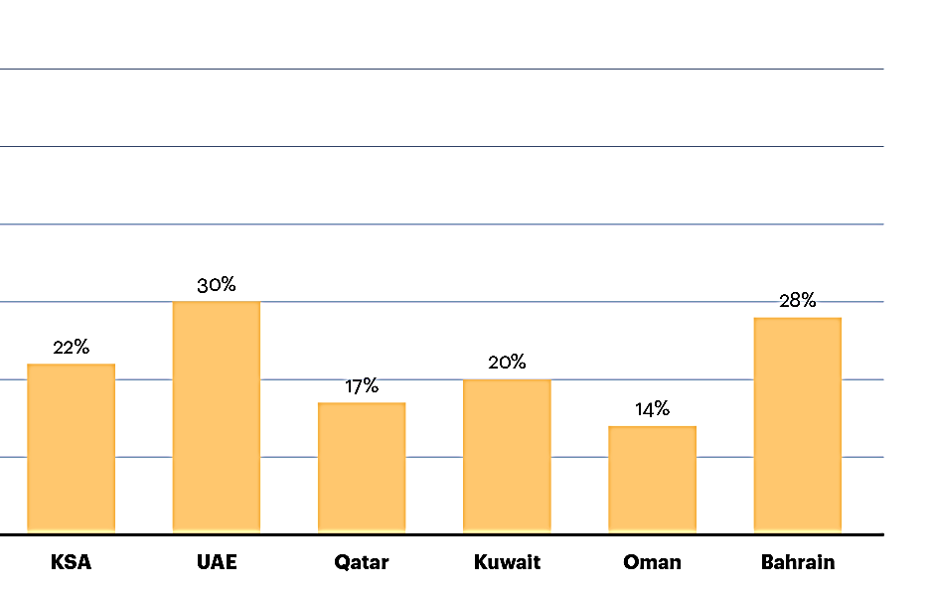
Self Employment in GCC
GCC Self Employment Contribution in Gross Domestic Product
Sustainable enterprises, forward-thinking SMEs can build a sustainable competitive advantage by innovating and commercializing on that innovation.
GCC countries have identified as gateways for diversifying their economies.
Sources: Saudi Ministry of Labor, NCB Capital, Dubai Chamber, Qatar Development Bank, Oman Commence and Industry Ministry, Capita Group International; A.T. Kearney analysis / www.atkearney.com/innovation/ideas-insights/article/-/asset_

Slide 13

Thank you!!

