Slide 1

Rules for Advancement in the Corporate World
Sabah Almoayyed
2008

Slide 2
INDEX
Corporate Structure
Distribution of Women and Men
Barriers to Career Enhancement
Understanding Your Rights
They Are Too Young or Too Old
They Need More Education and Experience
They Don’t Have the Right Qualification to Compete Effectively with Men
Commitment to Work
The Networking
They’ll Catch up Soon
Understanding Your Rights
The Relocation Challenge
Career Booster
1

Slide 3
INDEX
Understanding Your Rights
Nature of Jobs
Abilities/Career Commitment
There is life after work
Multiple Outside Commitment
Equality Between Work & Multiple Commitments
Performance Measurement as a Tool
Bottlenecks
The use of mentor as a measurement of further progress
Benefits of the Organization
Employees Benefits
Recommendations
2

Slide 4
Rules for Advancement in the Corporate World
Corporate Structure
Understanding your Rights
Performance Measurement As a Tool
Bottlenecks
The Use of Mentor As a Means of Further Management Objectives
3

Slide 5

CORPORATE STRUCTURE
General Distribution of Women and Men in Banking
Total Male : 150
63.5 %
Total Female : 86
36.5%
Total Staff Member 236
4

Slide 6
CORPORATE STRUCTURE
Women and Men in the Banking Sector (Average Sample)
Position | Male | Female
Executive | 2% | 1.1%
Senior Management | 9.3% | -
Managers | 5.3% | 4.6%
Section Head | 13.3% | 9.3%
Supervisory | 12.7% | 14%
Secretaries/Clerk | 57.4% | 71%
Ratio of Male & Female
Gender
5

Slide 7

1.CORPORATE STRUCTURE
Barriers to Career Enhancement
1. Inaccurate assumption and impression that govern men’s expectation of what women can achieve and women’s expectation of themselves.
6

Slide 8

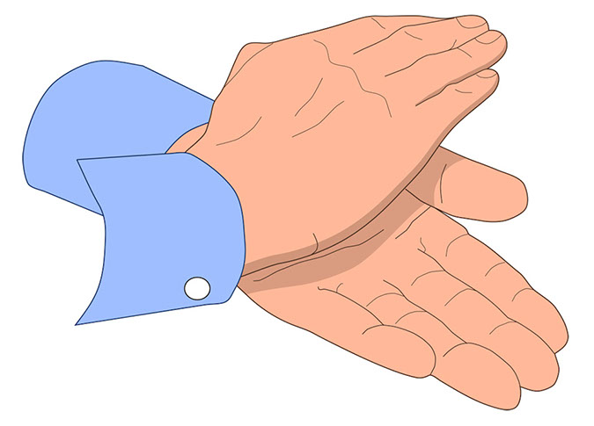
CORPORATE STRUCTURE
2. Lack of encouragement, access to opportunities, even information needed to achieve full potential. This is more recognize at senior level
7

Slide 9

CORPORATE STRUCTURE
3. Responsiveness to the various multitude of commitment outside the work place. Although this is experienced by men and women whenever they respond to Society’s commitment (family, education and community ),employer often questions women on their commitment to work and hence opportunities for advancement is limited.
8

Slide 10
2.UNDERSTANDING YOUR RIGHTS
If we question women’s position in Corporate Structure from the perspective of their superiors and why they are under-represented at senior levels of the organization, we will find the following reasons:
Too young or too old to compete with men promotion
Levels of education and experience required for women need to be higher in order to compete for the same position.
Less committed to their career.
Don’t have network to compete effectively with men.
9

Slide 11
They Are Too Young or Too Old
The Perception
Women at work are either too young or too old to compete with men for promotions
Conclusion:
Women and Men at the Bank certain levels i.e. (Manager, Supervisory, Secretary/Clerk) are on average similar
Age difference do not explain the under-representation of women in senior jobs .
Age must not determine eligibility for promotion.
10

Slide 12
They Need More Education and Experience
The Perception
The Levels of education and experience required for women need to be higher in order to compete
Question
Are women less educated than men?
The Reality
At the Supervisory Level we find the ratio of female to male as 60% - 40% respectively.
At the Secretarial level the ratio is about 55% female to 45% male who are educated.
11

Slide 13
They Don’t Have the Right Qualification to Compete Effectively With Men
The Perception
Women don’t have the right qualifications to compete with men for more senior positions.
Question
Are women weaker in job performance?
The Reality
Women can compete successfully for more senior positions.
12

Slide 14



Commitment to Work
The Perception
Women are less committed to their careers because they have babies and leave the bank while their children are young.
Reality
No. of female vs. male staff (less than five year
Male Female
39 % (59)* 52% (45)*
Total no. of Each Gender
No. of female vs. male staff (more than five years)
Male Female
61 % (91)* 48% (42)*
* Total no. of Each Gender
Conclusion
Men have longer services since women have entered more heavily in the banking sector in the last 5-7 years.
Women have shorter service senior levels, they are from outside the organization to the middle and senior management positions.
Being women does not reduce commitment
13

Slide 15

UNDERSTANDING YOUR RIGHTS
Networking
Have you developed NETWORK contacts to support your career advancement
Have you ever felt excluded from business related social gatherings (luncheon, dinners, tennis games) because you are a women?
Do you feel at ease with this surrounding?
The impact of lifting restricted access to business related networking opportunities.
They’ll Catch up Soon
The Perception
Time will take care of women advancement of women
to senior job at the bank.
Question
Is it only a matter of time until women move into senior positions?
The Reality
In general the private and public sector women are under represented at higher management level and it is not clear whether the leaders in that sector are doing anything about it.
Issues to be considered
Explore whether women in the organization (including yourself) have as many opportunities to advance as men.
Discuss with your Boss.
Request Career Plan .
14

Slide 16

UNDERSTANDING YOUR RIGHTS
The Relocation Challenges
Were promotions turned down by you because you didn’t want to relocate to new city/town?
Did you turn down the promotion or relocation because your husband or parents didn’t approve the move?
Have your decisions on advancement been influenced by the new demand of dual-career families, the increasing care for adult dependents and high expectations for quality of life?
Career Booster
Do you have same access to opportunities for career advancement? This is determined by the following:
Are you formally recognized as being a potential Manager?
Are you being sponsored or mentored by Senior staff?
Are you gaining viability with more Senior Management ?
Do men within your organization have high profile jobs (which means you have little access to high profile job)?
Nature of Job
Are you excluded from many jobs that have further potential for advancement because they are classified as male jobs vs. female jobs?
Have you tried to initiate a move to make the change?
15

Slide 17
UNDERSTANDING YOUR RIGHTS
Abilities/Career Commitment
Are your abilities being tested-Boss make assumption about your abilities, career commitment and interest.
If you are at Senior level, is this more the case?
What about your male peers, are they questioned in the same way?
16

Slide 18

UNDERSTANDING YOUR RIGHTS
There is Life after Work
Your Boss
Organizational Policy
Multiple Outside Commitment
Do men in your organization have the pressure that you have I terms of meeting multiple commitment to work, family, education?
Do Supervisors and Managers understand the needs of such employees and show flexibility in accommodating them to meet various responsibilities?
Is the percentage of support for men equal to women?
Is the organization doing a good job in accommodating employees with multiple commitment?
17

Slide 19

Multiple Outside Commitment
Career & Children
Are men or women who take maternity or child-care leave seen as to be less committed to their career and more towards their family?
How are those people perceived within their work environment?
18

Slide 20
Equality Between Work & Multiple Commitments
Part – Time work perception
How are part-time employees perceived in your organization?
Is part-time work viewed as a job rather than a career?
Are they seen as less committed to their career that full-timers?
Do they have equal opportunities for promotion and development?
19

Slide 21
3.PERFORMANCE MEASUREMENT AS A TOOL
What are the challenges facing men and women, how should you react to that :
Determine your objectives, work hard and diligently achieve those objectives.
Ask for clear career path including training and well identified job description, quantitative and qualitative objectives.
Regular Consultation- Consult with your supervisor on how best you could achieve your objectives, list all support areas required and don’t be afraid to speak up.
Appraisal Performance-ensure that the appraisal is fair. Discuss your achievement with an open mind to enhance your performance.
20

Slide 22
PERFORMANCE MEASUREMENT AS A TOLL
Don’t hesitate to take up outstanding matters where you feel the need for explanations required.
Recognize your right within the organization and demand authorities to perform your job.
21

Slide 23
4.BOTTLENECKS
How should you act with your counterparts (male or female)?
Be forthcoming, professional and matured in your approach.
Avoid being emotional
Watch your steps as you move forward and focus on your objectives
Be clear on your rights and obligations in dealing with your counterparts and supervisors (male or female).
22

Slide 24
5.THE USE OF MENTOR AS A MEANS OF FURTHER MANAGEMENT OBJECTIVES
How many of you have mentors?
Do you need mentors?
Role of mentors in terms of informing you on job opportunities and support your advancement within the organization.
Conclusion
Staff advancement within the organization is always enhanced if support is received from peer members or supervisor’s or even someone from another organization.
23

Slide 25

Benefits to the Organization
Do the employees see benefits arising from the organizations focus on promoting equality for women?
Will the organization focus on the advancement of women, result in improving
      Organizational Image
      Employee Moral
      Working environment
      Employee Productivity
      Competitive Position
24

Slide 26


EMPLOYEES BENEFITS
Are both men and women benefits similar?
Are they both aware of their needs?
Do you think they are satisfied with such benefits?
Do these benefits encourage them to reach to better working levels?
25

Slide 27
RECOMMENDATION
Create your own action plan which focuses on:
Keeping up the momentum, DON’T give up.
Increase awareness of your abilities, career, interest and extent of commitment.
Develop your skill with emphasis on leadership and team work.
Discuss your goals and potentials.
26

